Slide 1
Curves and Surfaces
Ed Angel
Professor of Computer Science, Electrical and Computer Engineering, and Media Arts
University of New Mexico
Angel: Interactive Computer Graphics 5E © Addison-Wesley 2009

Slide 2
Objectives
Introduce types of curves and surfaces
  Explicit
  Implicit
  Parametric
  Strengths and weaknesses
Discuss Modeling and Approximations
  Conditions
  Stability
Angel: Interactive Computer Graphics 5E © Addison-Wesley 2009

Slide 3
Escaping Flatland
Until now we have worked with flat entities such as lines and flat polygons
  Fit well with graphics hardware
  Mathematically simple
But the world is not composed of flat entities
  Need curves and curved surfaces
  May only have need at the application level
  Implementation can render them approximately with flat primitives
Angel: Interactive Computer Graphics 5E © Addison-Wesley 2009

Slide 4
Modeling with Curves
interpolating data point
data points
approximating curve
Angel: Interactive Computer Graphics 5E © Addison-Wesley 2009

Slide 5
What Makes a Good Representation?
There are many ways to represent curves and surfaces
Want a representation that is
  Stable
  Smooth
  Easy to evaluate
  Must we interpolate or can we just come close to data?
  Do we need derivatives?
Angel: Interactive Computer Graphics 5E © Addison-Wesley 2009

Slide 6
Explicit Representation
Most familiar form of curve in 2D
  y=f(x)
Cannot represent all curves
  Vertical lines
  Circles
Extension to 3D
  y=f(x), z=g(x)
  The form z = f(x,y) defines a surface
y
x
y
x
z
Angel: Interactive Computer Graphics 5E © Addison-Wesley 2009

Slide 7
Implicit Representation
Two dimensional curve(s)
  g(x,y)=0
Much more robust
  All lines ax+by+c=0
  Circles x²+y²-r²=0
Three dimensions g(x,y,z)=0 defines a surface
  Intersect two surface to get a curve
In general, we cannot solve for points that satisfy
Angel: Interactive Computer Graphics 5E © Addison-Wesley 2009

Slide 8
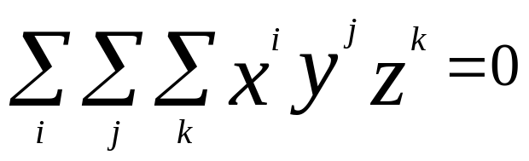
Algebraic Surface
Quadric surface 2 ≥ i+j+k
At most 10 terms
Can solve intersection with a ray by
reducing problem to solving quadratic equation
Angel: Interactive Computer Graphics 5E © Addison-Wesley 2009

Slide 9
Parametric Curves
Separate equation for each spatial variable
  x=x(u)
  y=y(u)
  z=z(u)
For u_{max} ≥ u ≥ u_{min} we trace out a curve in two or three dimensions
p(u)=[x(u), y(u), z(u)]^{T}
p(u)
p(u_{max})
p(u_{min})
Angel: Interactive Computer Graphics 5E © Addison-Wesley 2009

Slide 10
Selecting Functions
Usually we can select “good” functions
  not unique for a given spatial curve
  Approximate or interpolate known data
  Want functions which are easy to evaluate
  Want functions which are easy to differentiate
    Computation of normals
    Connecting pieces (segments)
  Want functions which are smooth
Angel: Interactive Computer Graphics 5E © Addison-Wesley 2009

Slide 11
Parametric Lines
We can normalize u to be over the interval (0,1)
Line connecting two points p₀ and p₁
p(1)= p₁
p(u)=(1-u)p₀+up₁
p(0) = p₀
p(1)= p₀ +d
Ray from p₀ in the direction d
p(u)=p₀+ud
d
p(0) = p₀
Angel: Interactive Computer Graphics 5E © Addison-Wesley 2009

Slide 12
Parametric Surfaces
Surfaces require 2 parameters
x=x(u,v)
y=y(u,v)
z=z(u,v)
p(u,v) = [x(u,v), y(u,v), z(u,v)]^{T}
Want same properties as curves:
  Smoothness
  Differentiability
  Ease of evaluation
y
p(u,1)
p(0,v)
p(1,v)
x
z
p(u,0)
Angel: Interactive Computer Graphics 5E © Addison-Wesley 2009

Slide 13
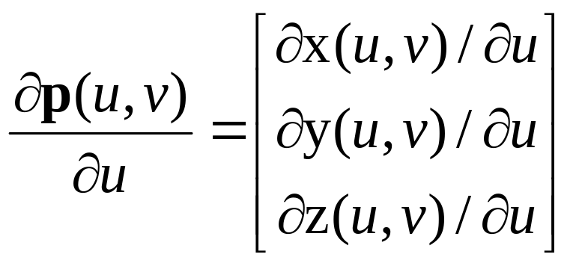
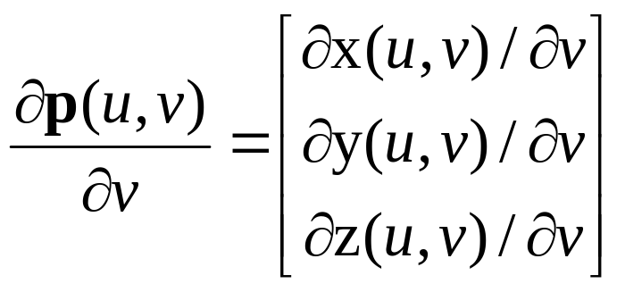
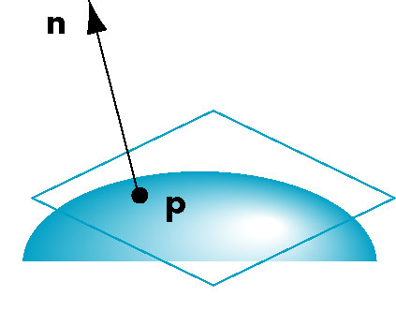
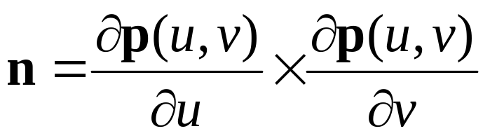
Normals
We can differentiate with respect to u and v to obtain the normal at any point p
Angel: Interactive Computer Graphics 5E © Addison-Wesley 2009

Slide 14
Parametric Planes
n
point-vector form
r
p(u,v)=p₀+uq+vr
n = q x r
q
p₀
n
three-point form
p₂
q = p₁ – p₀
r = p₂ – p₀
p₁
p₀
Angel: Interactive Computer Graphics 5E © Addison-Wesley 2009

Slide 15
Parametric Sphere
x(u,v) = r cos θ sin φ
y(u,v) = r sin θ sin φ
z(u,v) = r cos φ
360 ≥ θ ≥ 0
180 ≥ φ ≥ 0
constant: circles of constant longitude
φ constant: circles of constant latitude
differentiate to show n = p
Angel: Interactive Computer Graphics 5E © Addison-Wesley 2009

Slide 16
Curve Segments
After normalizing u, each curve is written
p(u)=[x(u), y(u), z(u)]^{T}, 1 ≥ u ≥ 0
In classical numerical methods, we design a single global curve
In computer graphics and CAD, it is better to design small connected curve segments
p(u)
join point p(1) = q(0)
q(1)
q(u)
p(0)
Angel: Interactive Computer Graphics 5E © Addison-Wesley 2009

Slide 17
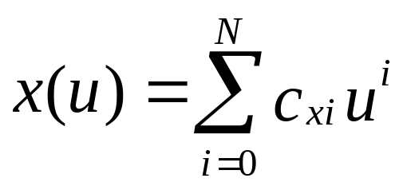
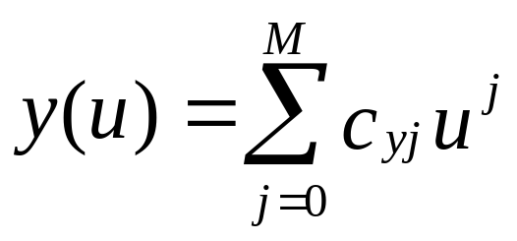
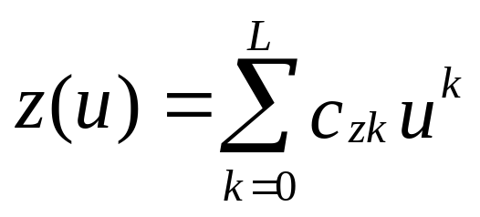
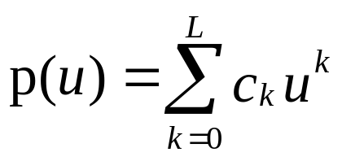
Parametric Polynomial Curves
If N=M=K, we need to determine 3(N+1) coefficients
Equivalently we need 3(N+1) independent conditions
Noting that the curves for x, y and z are independent,
we can define each independently in an identical manner
We will use the form
where p can be any of x, y, z
Angel: Interactive Computer Graphics 5E © Addison-Wesley 2009

Slide 18
Why Polynomials
Easy to evaluate
Continuous and differentiable everywhere
  Must worry about continuity at join points including continuity of derivatives
p(u)
q(u)
join point p(1) = q(0)
but p’(1) ≠ q’(0)
Angel: Interactive Computer Graphics 5E © Addison-Wesley 2009

Slide 19
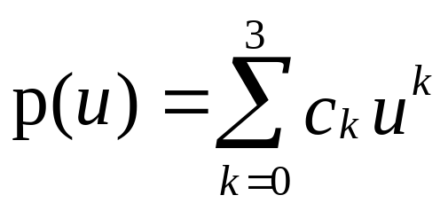
Cubic Parametric Polynomials
N=M=L=3, gives balance between ease of evaluation and flexibility in design
Four coefficients to determine for each of x, y and z
Seek four independent conditions for various values of u resulting in 4 equations in 4 unknowns for each of x, y and z
  Conditions are a mixture of continuity requirements at the join points and conditions for fitting the data
Angel: Interactive Computer Graphics 5E © Addison-Wesley 2009

Slide 20
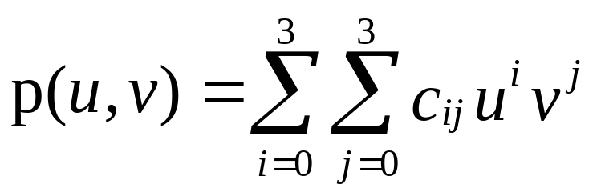
Cubic Polynomial Surfaces
p(u,v)=[x(u,v), y(u,v), z(u,v)]^{T}
where
p is any of x, y or z
Need 48 coefficients ( 3 independent sets of 16) to
determine a surface patch
Angel: Interactive Computer Graphics 5E © Addison-Wesley 2009

